Slide 1
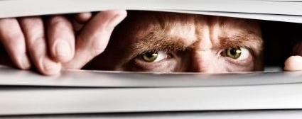
Just looking for your attendance

Slide 2
Review

Slide 3
Word Frequency in a Corpus
What is this distribution called?

Slide 4
Zipf’s Law: The frequency of a word is inversely related to its rank in a word frequency matrix.
In language this means we should expect some words to be more frequent.
Observation or Word A appears N times
Word B is expected to appear N/2
Word C is expected to appear N/3
Word D is expected to appear N/4
…
…
Term Rank
https://www.worlddata.info/average-income.php
B_Frequency_Associations.R

Slide 5
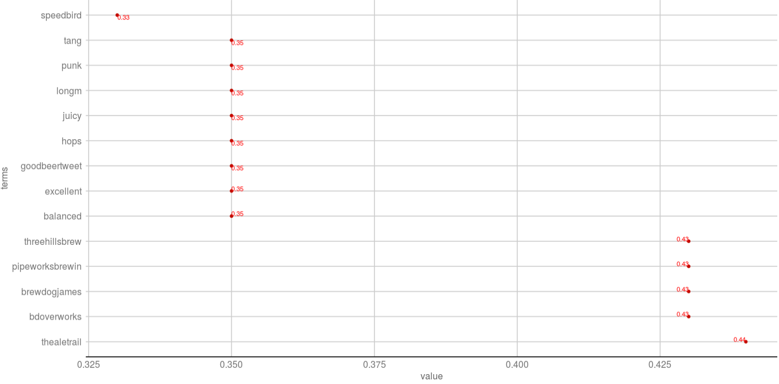
Associations, like correlation
When word X appears what proportion of the time does word Y appear?
B_Frequency_Associations.R

Slide 6
Dendrograms: Hierarchical Clusters
Visualizes hierarchical data. For text, the frequency distances are calculated to create the hc object.
Real Rainfall Data
Rainfall Data as a Dendrogram
63
City | Annual Rainfall
Portland | 43.5
Boston | 43.8
New Orleans | 62.7
44
Boston
Portland
New Orleans
C_Dendrograms_WordNetworks.R

Slide 7
Word Networks…Social Network Analysis
Always hard to interpret, what terms are associated with the initial string at varying degrees of separation. i.e. associations of associations
word_associate(assocText,
match.string = 'brewdog',
stopwords = networkStops,
network.plot = T,
cloud.colors = c('black','darkred'))
C_Dendrograms_WordNetworks.R

Slide 8
Word cloud of Term Associations
Always hard to interpret, what terms are associated with the initial string at varying degrees of separation. i.e. associations of associations
word_associate(assocText,
match.string = 'brewdog',
stopwords = networkStops,
wordcloud = T,
cloud.colors = c('black','darkred'))
C_Dendrograms_WordNetworks.R

Slide 9

A safe/supportive learning environment
This text has never been read. “Keyboard Courage” is rampant which may entail some less than ideal topics.
Twitter is a realistic Natural Language Channel
It is a great place to get topics, and messy challenging data.
As a safe learning environment, no offense is intended, merely exposure to a real data set. If offended, please reach out and I will get you additional data sets.
#%@*!!!

Slide 10
Review of Basic Text Visuals
﻿live_A_simple_wordcloud.R
﻿live_B_comparisonCloud_bankLoans.R
﻿live_C_RapSongs.R
Optional:﻿
live_C_RapSongs_censored.R

Slide 11
Let’s make some pyramids

Slide 12

Steps for a pyramid plot…collapse
Combined/Collapsed
into a 2 document corpus
CorpusA – 1000 Tweets
Clean & Collapse
CorpusB – 1000 Tweets
Clean & Collapse

Slide 13
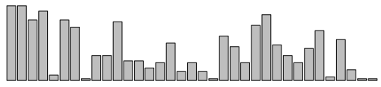
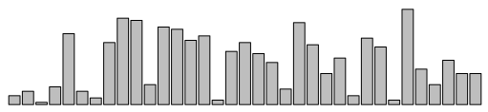
Steps for a pyramid plot…ID common tokens & frequency

Slide 14
Build a “pyramid plot” of frequencies
termA
termB
…
TermN

Slide 15
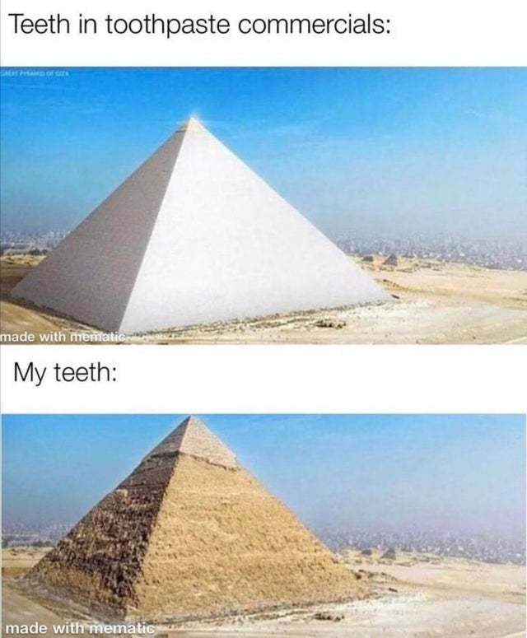
Open ﻿live_D_Pyramid_plots.R

Slide 16

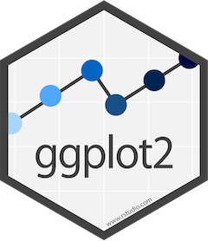
Open ﻿live_E_other_wordcloud_libs.R

Slide 17
Lab/Homework
Day2_HW.R

Slide 18
Experimental_Z_Retailers_polarized_wordcloud.R

